Slide 1










POSTDOCTORAL RESEARCH PROPOSAL
MULTI-SENSOR IMAGE MATCHING FOR EARTH SURFACE DEFORMATION MONITORING
ANDRE STUMPF
PERSONAL BACKGROUND
2008: MSc in Physical Geography & Geomatics (TU Dresden, Germany)
2007: Student research assistant –
ASTER stereo-photogrammetry
UFZ Helmholtz Centre – Leipzig
2009: Research assistant – Landslide hazard assessment (Inst. Of Geophysics, University of Chile)
2010: Research assistant – Landslide Remote Sensing (ITC- Fac. of Geo-Information Science and EO, Netherlands)
PhD RESEARCH (Oct 2010- Oct 2013)
Mapping and Monitoring of Landslides through Passive Optical Remote Sensing
Joint – program between
Laboratoire Image, Ville et Environnment
(Christiane Weber, Anne Puissant)
École et Observatoire des Sciences de la Terre
(Jean-Philippe Malet)
ITC-Faculty of Geo-Information Science
and Earth Observation
(Norman Kerle)
Laboratoire Icube
(Nicolas Lachiche, Thomas Lampert, Camille Curtz)
Active participation (3 deliverables) in the project SafeLand (FP-7) and FOSTER (ANR)
IPGS

Slide 2
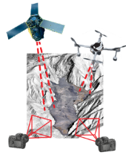
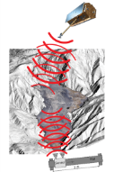
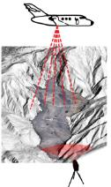
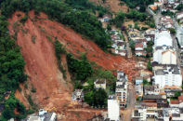
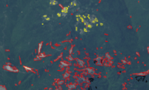
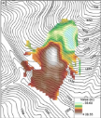
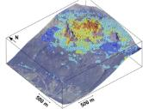
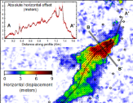
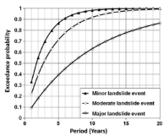
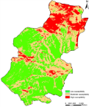
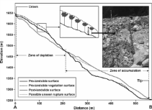
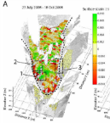
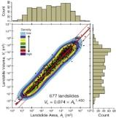
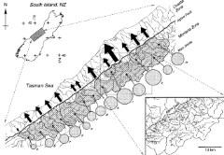
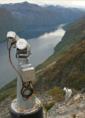
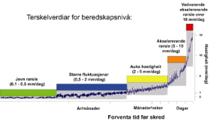
ANDRE STUMPF - MULTI-SENSOR IMAGE MATCHING FOR EARTH SURFACE DEFORMATION MONITORING
REMOTE SENSING OF LANDSLIDES
TECHNOLOGY
PASSIVE OPTICAL
RADAR
LiDAR
INVENTORY MAPPING
Disaster management
Hazard assessment
Quantification of erosion rates
MONITORING
Volumes / Displacement rates
Infer mechanical processes
Early warning
ENVIRON-MENTAL VARIABLES
Topography
Geology
Soils
Vegetation
Land Cover
Land Use
Precipitation
…
APPLICATIONS

Slide 3
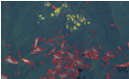
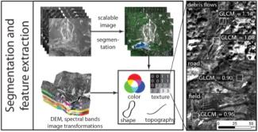
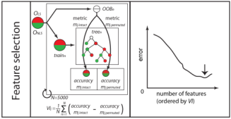
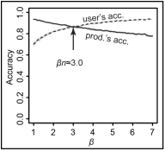
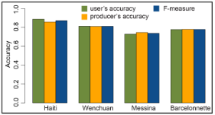
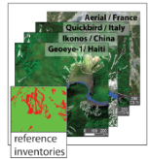
PhD RESEARCH 1: RAPID LANDSLIDE INVENTORY MAPPING
Design of image features particularly well-suited for the recognition of landslides in VHR remote sensing images
Application of the Random Forest algorithm for automatic sample-based feature selection
Adaptation of the Random Forest algorithm to handle inherent class-imbalance
Evaluation at four different test sites with state-of-the are VHR satellite and aerial images
Stumpf & Kerle 2011a (RSE), Stumpf & Kerle 2011b (Proc. Environ. Sc.)
Lu & Stumpf, et al. 2011 (IEEE GRSL)

Slide 4
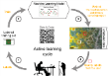
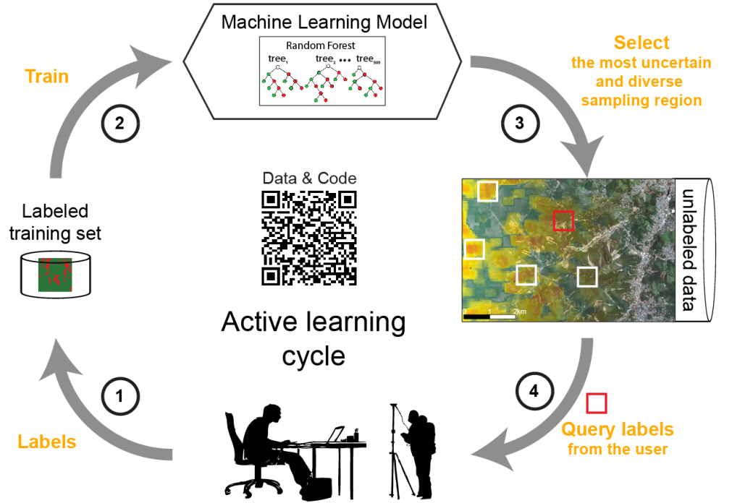



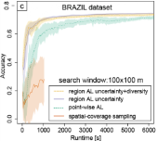
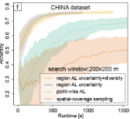
PhD RESEARCH 2: REDUCTION OF TRAINING DATA
Query – avoid disperse
sample distribution!
Assessment of real labeling costs and expert uncertainty
Resampling method to handle inherent class-imbalance
Region-based query function with an objective-function that combines sample uncertainty and sample diversity
Evaluation with multi-sensor data at two test sites
Data and R Code: http://eost.unistra.fr/recherche/ipgs/dgda/dgda-perso/andre-stumpf/data-and-code/
Stumpf et al. in Press (IEEE TGRS), Stumpf et al. 2012, (ECML-PKDD),
Lampert, Stumpf, Gançarski, under review (IJCV)

Slide 5
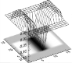
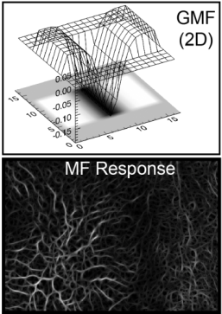
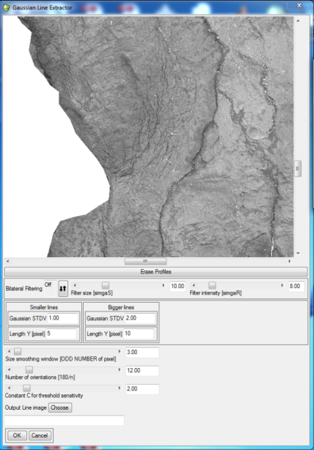
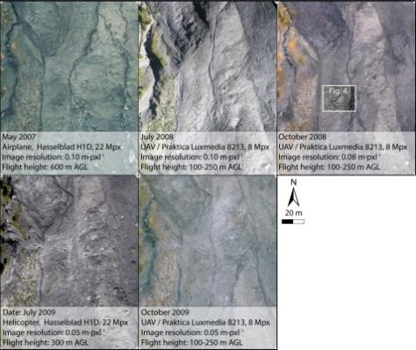
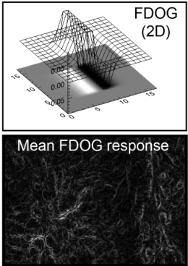
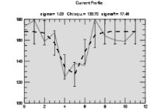
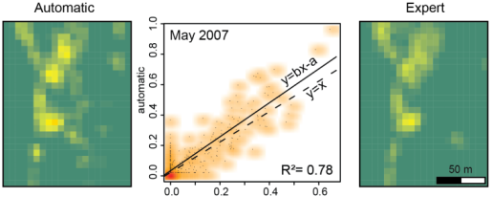
PhD RESEARCH 3: MAPPING AND MONITORING OF LANDSLIDE SURFACE FISSURES IN UAV IMAGES
Gaussian matched filters
& morphological filtering
Evaluation against expert mappings with multi-sensor images
ENVI-IDL interface
Stumpf et al. 2013 (Geomorphology), Stumpf et al. 2012a (IEEE IGARSS),
Stumpf et al. 2012b (GEOBIA)

Slide 6
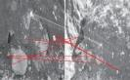
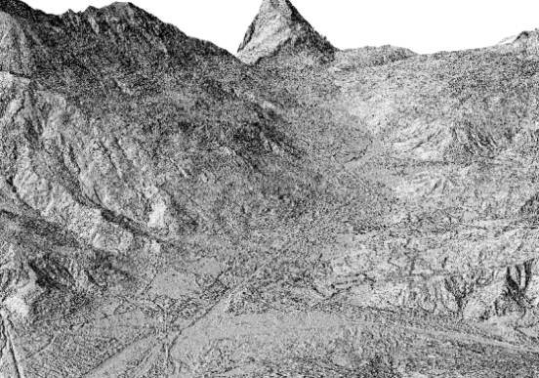
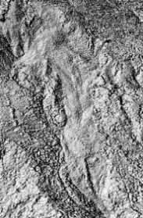
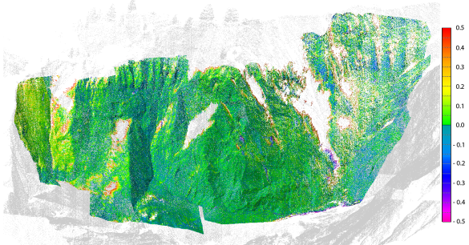
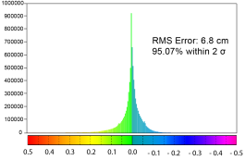

PhD RESEARCH 4: TERRESTRIAL MULTI-VIEW AND SATELLITE STEREO PHOTOGRAMMETRY FOR LANDSLIDE MONITORING
Accuracy assessment of DSM derived from Pleiades stereo-pairs
Removal of terrain distortion preceding image sub-pixel image correlation
Evaluation of ASIFT for the co-registration of highly oblique views
Iterative Bundle-adjustment and quantitative evaluation of dense multi-view stereo
(IGN’s Apero, MicMac vs. PMVS)
Quantification of displacement and erosion
… to be finished mid October 2013!
Stumpf et al. 2013 (EGU)

Slide 7

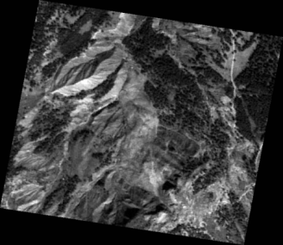
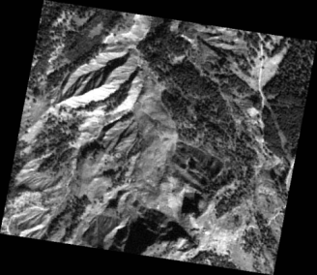
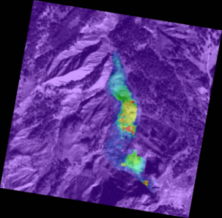
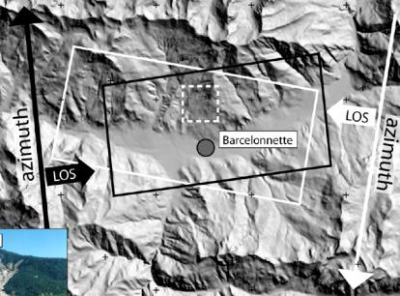
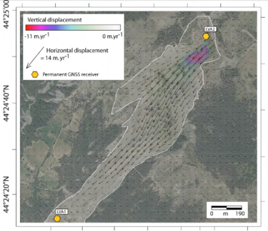
POST-DOCTORAL RESEARCH PROPOSAL
MOTIVATION
State of the art of landslide displacement monitoring from space
Digital Image Correlation of optical images and SAR
7m
4m
2m
0
2-D (XY)
displacement
SPOT 5 July 2003 SPOT 5 June 2004 (Thomas 2005)
2-D (Range-Azimuth)
3-D with good coverage of ascending and descending orbits
TerraSAR-X Spotlight April–November 2010
(Raucoules et al. 2013)

Slide 8
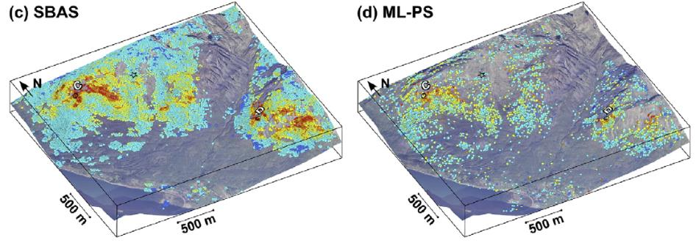
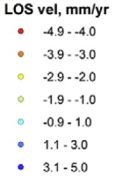
POST-DOCTORAL RESEARCH PROPOSAL
MOTIVATION
State of the art of landslide displacement monitoring from space
SAR interferometry
Increasingly easier access to suitable satellite data (GMES/Copernicus – Sentinel missions)
Combining observations from different satellites / processing techniques would enable to better analyze diverse displacement mechanisms and to obtain long-term time series that capture rapid changes in the displacement rates!
LOS
displacement
18 ERS-1/2 SAR images 1992 -1999, (Lauknes et al. 2010)

Slide 9
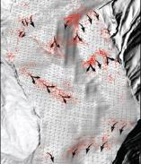
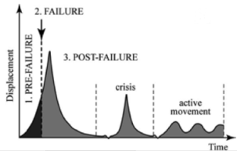
POST-DOCTORAL RESEARCH PROPOSAL
MOTIVATION
Current limitations
Landslide specific challenges
Limited spatio-temporal coverage with individual satellite systems (geometry, decorrelation, etc.)
Difficulties to measure and integrate displacement vectors with different methods / systems
due to
Lack of tools to integrate images from different acquisition geometries and modalities
Precise relative displacement (to reference image) does not guarantee precise geolocation
Complex long-term displacement pattern of rapidly changing magnitudes
requires
Dense and long-term 3-D displacement measurements to infer underlying mechanical processes
requires
Precise geolocation for integration of multi-satellite and ground-measurements (OMIV + IPGS)

Slide 10

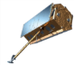

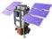
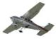


POST-DOCTORAL RESEARCH PROPOSAL
OBJECTIVES
MULTI-SENSOR IMAGE MATCHING
FOR EARTH SURFACE DEFORMATION MONITORING
A: Evaluation of robust and precise image matching algorithms
B: Implementation and evaluation of a method for multi-sensor image co-registration
C: Application of hierarchical image correlation for displacement measurement and DSM generation
D: Joint inversion of 2-D and 1-D (LOS) displacement vectors into continuous 3-D time-series
E: Development and processing largely based on Open Source projects
Host organization: IPGS / OMIV (Barcelonnette – CNES validation site)
Jean-Philippe Malet, Cécile Doubre
Collaboration: Marc Pierrot-Deseilligny (IGN, ENSG)
Pascal Allemand (CNRS UMR 5570, Université de Lyon)

Slide 11

D
POST-DOCTORAL RESEARCH PROPOSAL
OBJECTIVE D
Use of up-to-date stereo-photogrammetric DEMs to replace commonly used SRTM

Slide 12

C
POST-DOCTORAL RESEARCH PROPOSAL
OBJECTIVE C
Derived DSM can be used for
Orthorectification other VHR images preceding displacement measurements
Enhance removal of the topographic noise during SAR processing

Slide 13

B
POST-DOCTORAL RESEARCH PROPOSAL
OBJECTIVE B

Slide 14

A
POST-DOCTORAL RESEARCH PROPOSAL
OBJECTIVE A

Slide 15







E
POST-DOCTORAL RESEARCH PROPOSAL
OBJECTIVE E
Development and processing largely based on OpenSource software libraries
Matching algorithms
RPC sensor-modeling
Inversion of 3D-displacement
Hierarchical Image correlation
InSAR
sba : A Generic Sparse Bundle
Adjustment C/C++ Package
MicMac
ROI_PAC
Validation at OMIV sites (Validation site for CNES products)
1st year: Implementation and Testing
2nd year: Application and Validation

Slide 16






MULTI-SENSOR IMAGE MATCHING FOR EARTH SURFACE DEFORMATION MONITORING
Andre STUMPF
QUESTIONS?
IPGS

